Slide 1

Datamind: Addressing youth depression & suicide in Finland
Junction 2019 Helsinki Hackathon
CGI/Sitra Healthtech Challenge:
Reimagine mental health care
Team name: CommonSens
Team members:
Sahar Elsayes
Daniel Gregory
Garold Murdachaew
Omer Nizri
Aliya Yakubova (consultant)

Slide 2
The problem: Approximately 20-25% of Finnish youth have mental health issues
Depression
Anxiety
Eating disorder
Self-harm, suicidal ideation & suicide

Slide 3
The implications: Moral & economic
Youth suicide is a national tragedy
Youth depression & mental health problems lead to non-productive adults
Pension & welfare systems rely on productive economy; else unsustainable

Slide 4
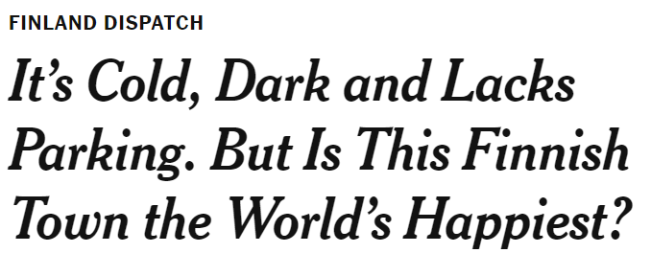




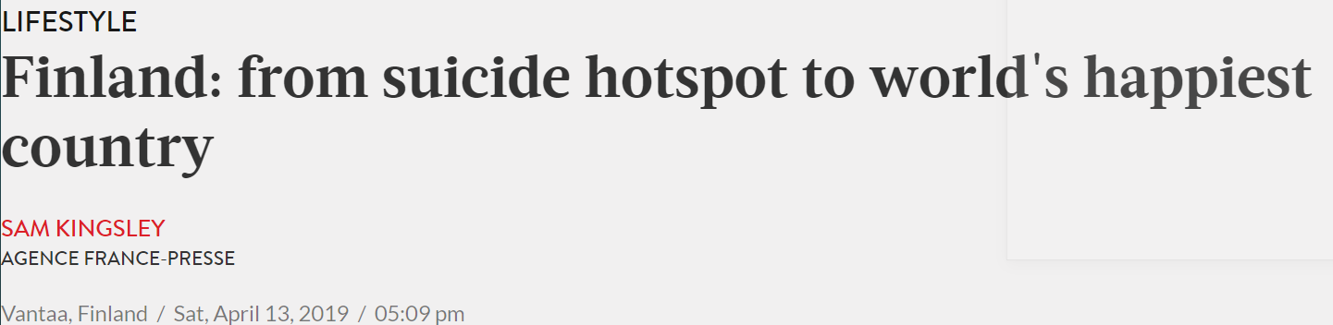


Slide 5
United Nations Sustainable Development Solutions Network: World Happiness Report (2019)
Overall rank | Country or region | Score | GDP per capita | Social support | Healthy life expectancy | Freedom to make life choices | Generosity | Perceptions of corruption
1 | Finland | 7.769 | 1.340 | 1.587 | 0.986 | 0.596 | 0.153 | 0.393
2 | Denmark | 7.600 | 1.383 | 1.573 | 0.996 | 0.592 | 0.252 | 0.410
3 | Norway | 7.554 | 1.488 | 1.582 | 1.028 | 0.603 | 0.271 | 0.341
7 | Sweden | 7.343 | 1.387 | 1.487 | 1.009 | 0.574 | 0.267 | 0.373
9 | Canada | 7.278 | 1.365 | 1.505 | 1.039 | 0.584 | 0.285 | 0.308
19 | United States | 6.892 | 1.433 | 1.457 | 0.874 | 0.454 | 0.280 | 0.128
68 | Russia | 5.648 | 1.183 | 1.452 | 0.726 | 0.334 | 0.082 | 0.031

Slide 6
United Nations Sustainable Development Solutions Network: World Happiness Report (2019)
Overall rank | Country or region | Score | GDP per capita | Social support | Healthy life expectancy | Freedom to make life choices | Generosity | Perceptions of corruption
1 | Finland | 7.769 | 1.340 | 1.587 | 0.986 | 0.596 | 0.153 | 0.393
147 | Haiti | 3.597 | 0.323 | 0.688 | 0.449 | 0.026 | 0.419 | 0.110
152 | Rwanda | 3.334 | 0.359 | 0.711 | 0.614 | 0.555 | 0.217 | 0.411
153 | Tanzania | 3.231 | 0.476 | 0.885 | 0.499 | 0.417 | 0.276 | 0.147
156 | South Sudan | 2.853 | 0.306 | 0.575 | 0.295 | 0.010 | 0.202 | 0.091

Slide 7
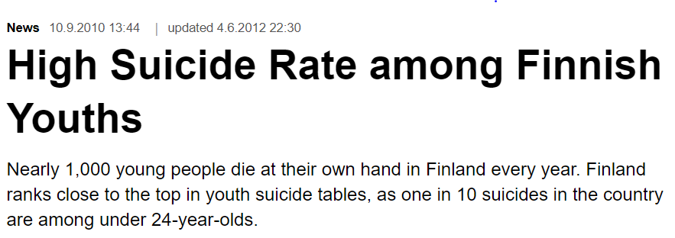
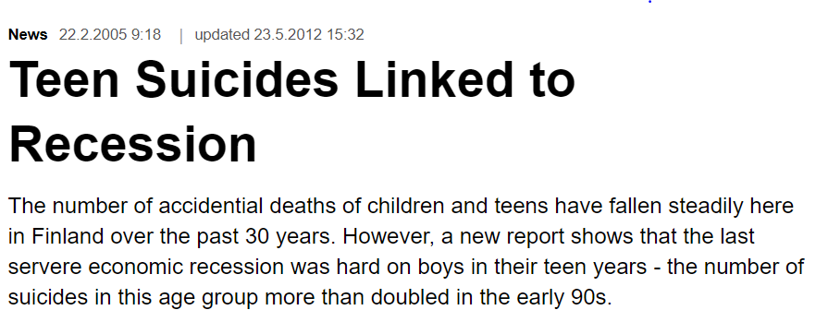
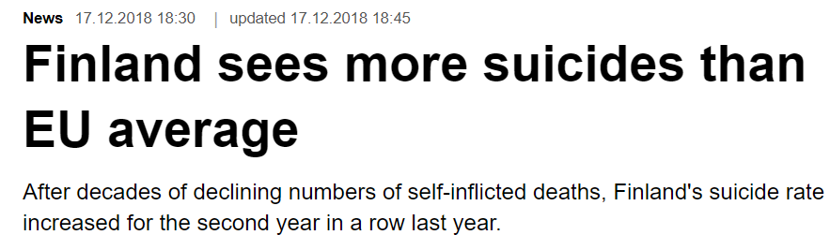
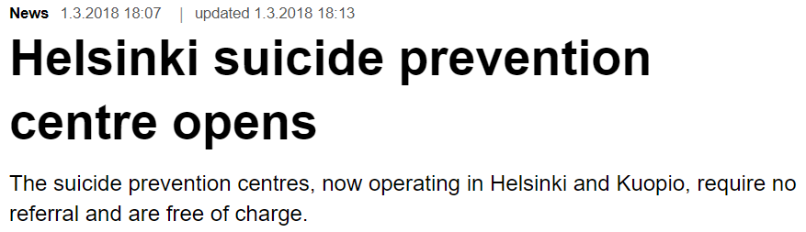

Slide 8
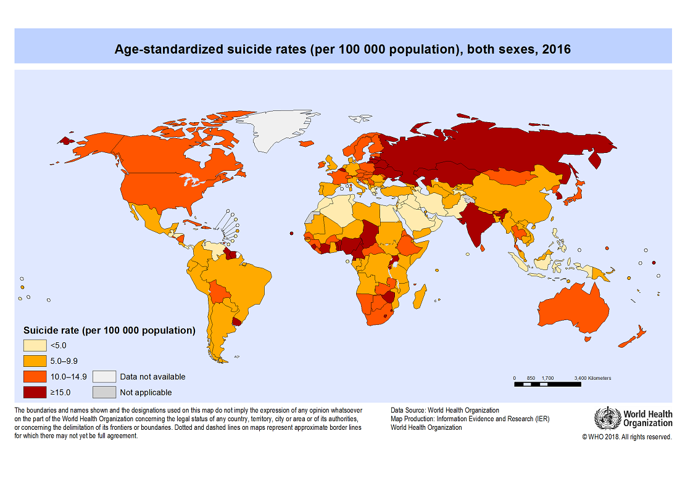

Slide 9
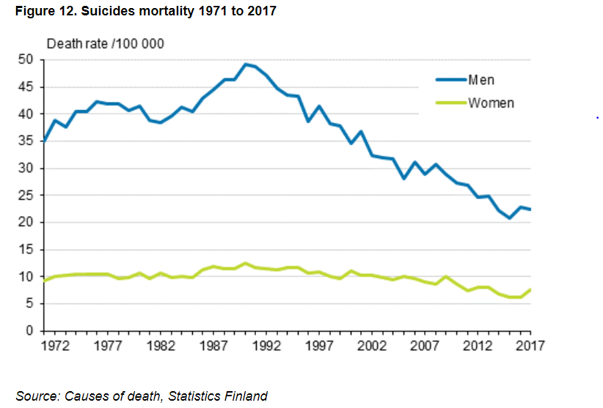
Suicide rates in Finland have dropped over past 20 years …
Men commit more suicides than women
Rates have dropped over past 20 years, mainly amongst the middle-aged
For >65, suicide mortality in Finland did not differ from EU average

Slide 10
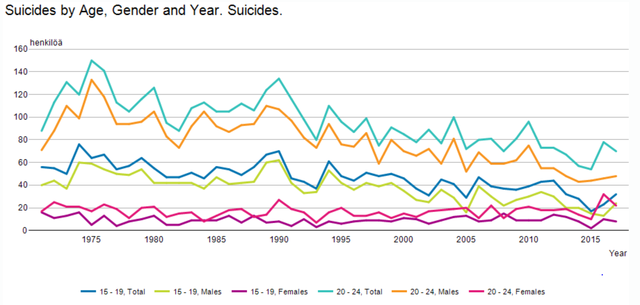
Suicide rates in Finland have dropped over past 20 years … but not so much for youth
Youth suicide rates have not dropped as much and in fact have recently risen slightly
(Suicide as cause of death for young people often dominates because mortality due to other causes is low)
Finnish young people (15-24) suicide mortality in Finland is high compared to EU average
There is a problem!

Slide 11
New national suicide prevention program (part of Finnish national mental health strategy for 2019-2030)
Objective is to reduce suicide rates 10% (goal of the WHO for all member countries) by:
Increase training of social and health professionals
More efficient use of evidence-based practices and new electronic methods in particular
Closely monitor those who attempted suicide; offer appropriate services immediately after attempt
Offer support to family of suicide victims / survivors
More cooperation between experts, early support offered by organisations / health care system
Strongly support high-quality and humane care culture
Notes:
We will focus on the bolded items in our proposal. Training of volunteer peer counselors will also be emphasized. Also optimizing better and faster allocation of resources (i.e., psychiatrists) for those with severe depression.

Slide 12
Prevention is better & cheaper than cure:
Investment during (early) childhood is critical¹
Young mothers & infants (pre-natal & post-natal)
Health, diet, avoidance of drugs & alcohol, social support
(Finland & Nordic countries are good at this)
We propose this in addition: Peer mentoring of young parents
Mothers
Fathers
¹It takes a village to raise a child -- African proverb

Slide 13
But young adulthood is difficult, with many pressures
School & life decisions
Peers
Sexuality
Social media

Slide 14
Some ideas to improve youth mental health
Data-driven triage & assessment of depression severity
Severe -> Immediate assistance (currently there is an unacceptable delay)
Moderate-to-mild -> Peer-support, referral
Volunteer organization¹ connected to Mieli² that can match at-risk youth to trained & supervised peer support:
In-person meetings
Video conferencing
Longitudinal tracking of treatment outcomes
¹Analogous to Big Brothers & Big Sisters USA
²Mental Health Finland

Slide 15
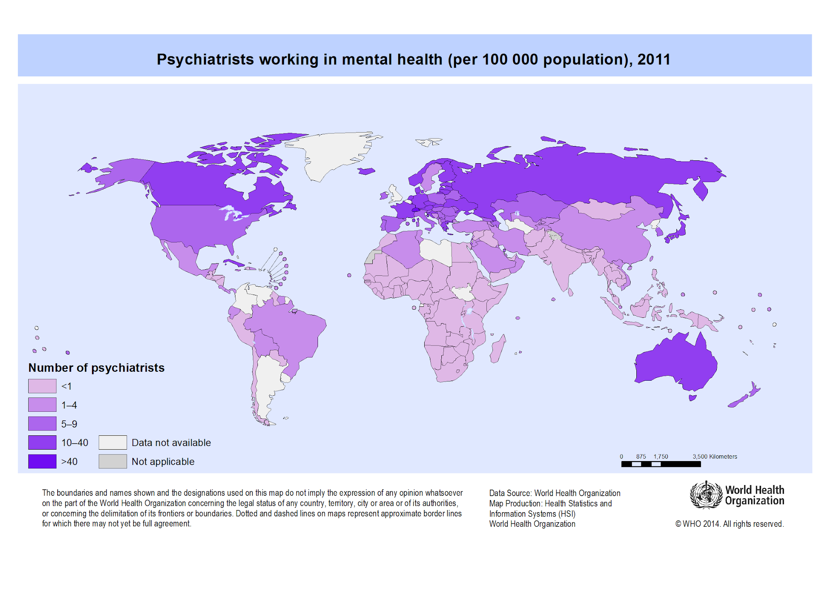

Slide 16
Common data-driven approach to classifying degree of depression: Patient Health Questionnaire¹ (If initial assessment PHQ-2 > 2, then if PHQ-9 > 9 -> depression serious)
How often have they been bothered by the following over the past 2 weeks?
0=Not at all 1=Several days 2=More than half the days 3=Nearly every day
1. Little interest or pleasure in doing things?
2. Feeling down, depressed, or hopeless?
3. Trouble falling or staying asleep, or sleeping too much?
4. Feeling tired or having little energy?
5. Poor appetite or overeating?
6. Feeling bad about yourself - or that you are a failure or have let yourself or your family down?
7. Trouble concentrating on things, such as reading the newspaper or watching television?
8. Moving or speaking so slowly that other people could have noticed?
Or the opposite - being so fidgety or restless that you have been moving around a lot more than usual?
9. Thoughts that you would be better off dead, or of hurting yourself in some way?
¹Diagnostic and Statistical Manual of Mental Disorders (DSM-IV & V)

Slide 17
Interpretation of PHQ-9 score
PHQ-9 Score | Depression severity | Suggested Intervention
0-4 | None-minimal | None
5-9 | Mild | Repeat PHQ-9 at follow-up
10-14 | Moderate | Make treatment plan, consider counseling, follow-up, and/or prescription drugs
15-19 | Moderately Severe | Prescribe prescription drugs and counseling
20-27 | Severe | Prescribe prescription drugs. If there are poor responses to treatment, immediately refer the patient to a mental health specialist for counseling.

Slide 18
Data our app will gather
PHQ-9 data to classify severity
Free-form text in form of short biography will be used to confirm degree of severity or at-risk status
Bio can identify type of mental health issue and personalize the proposed treatment
Bio text will be analyzed with natural language processing (NLP) techniques
sentiment analysis
word2vec, doc2vec
Data from multiple other sources

Slide 19

Training algorithm – phase 1
Data cleaning and normalization
Concatenate the feature vectors $\vec{v_{1}},…, \vec{v_{n}}$ to create feature vector $\vec{v}$
Perform PCA to create vector $\vec{v′}$
Apply clustering, possibly DBSCAN (algorithm that doesn’t have a parameter for the number of clusters)

Slide 20
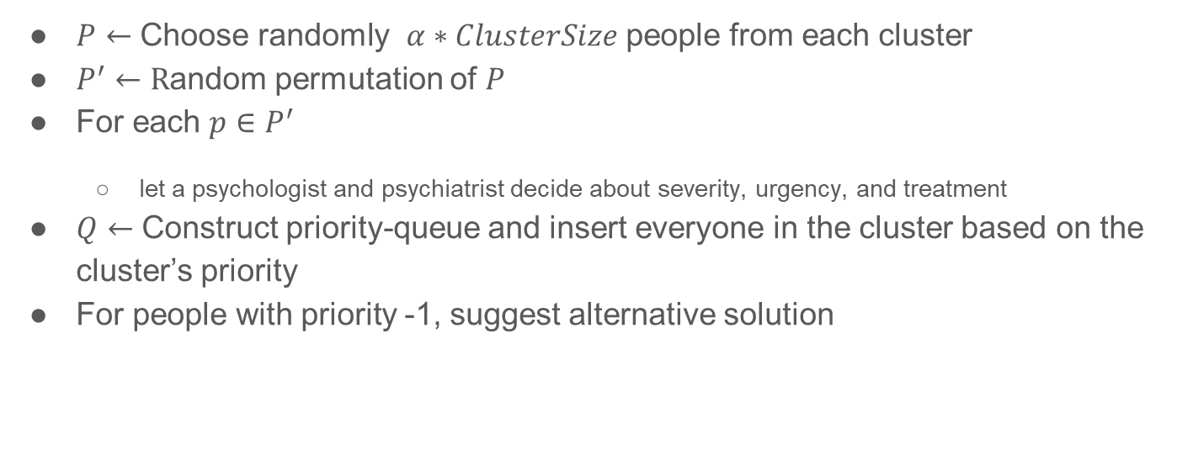
Training algorithm – phase 2
$P←$ Choose randomly $α∗ClusterSize$ people from each cluster
$P^{′}←R$andom permutation of $P$
For each $p∈P^{′}$
let a psychologist and psychiatrist decide about severity, urgency, and treatment
$Q←$ Construct priority-queue and insert everyone in the cluster based on the cluster’s priority
For people with priority -1, suggest alternative solution

Slide 21
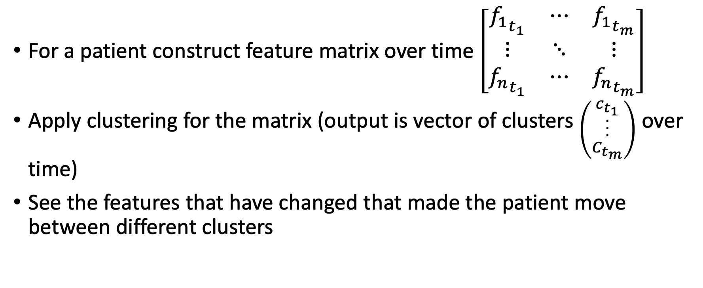
Root causes analysis and depression prediction
For a patient construct feature matrix over time $\left[\begin{matrix}{f_{1}}_{t_{1}} & ⋯ & {f_{1}}_{t_{m}} \\ ⋮ & ⋱ & ⋮ \\ {f_{n}}_{t_{1}} & ⋯ & {f_{n}}_{t_{m}}\end{matrix}\right]$
Apply clustering for the matrix (output is vector of clusters $\left({c_{t_{1}} \atop \begin{aligned}. \\ . \\ . \\ C_{t_{m}}\end{aligned}}\right)$ over time)
See the features that have changed that made the patient move between different clusters

Slide 22
Our app: Use cases
Prospective patients & patients
Carers
Primary care physicians, psychologists & counselors
Teachers
Patient’s parents (if under 18)
Peer counselors
Researchers: Good data may allow classification of depression subtype & more focused treatment (see: “Applying a neural circuit taxonomy in depression and anxiety for personalized psychiatry”, LM Williams, et al., Personalized Psychiatry, 499-519, 2020)

Slide 23
Privacy & data security: Stakeholders
Patient
Patient’s parents (if under 18)
Doctor
Mieli

Slide 24
The Future ….
Addressing youth depression through data-driven precision psychiatry

Slide 25
Treatment-resistant depression is a hard problem
Recent fMRI studies suggest that depressive disorders actually consist of multiple subtypes with their individual mechanisms and distinctive symptoms (if resolved on fine-enough and accurate scale)
Tasks:
(1) identify subtype (good data can help)
(2) neurobiologists can decipher mechanism
(3) finally prescribe appropriate treatment
In short, we desire to use a scalpel, not a blunderbuss

Slide 26
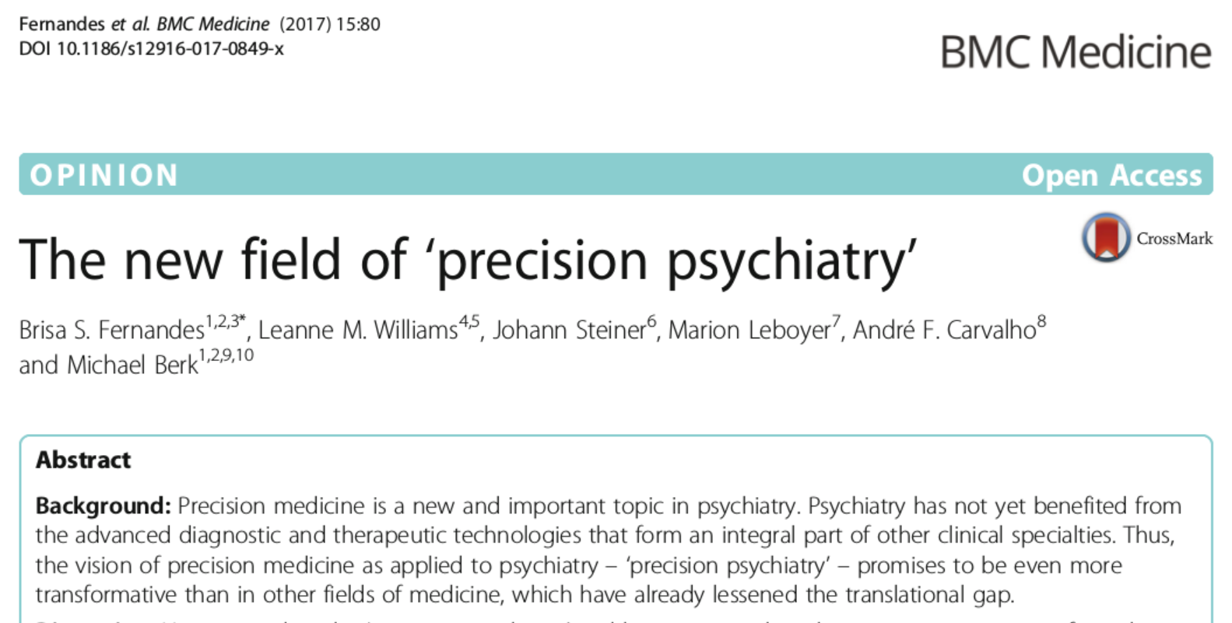
Leanne M.Williams, Andrea N.Goldstein-Piekarski, ‘Chapter 42 - Applying a neural circuit taxonomy in depression and anxiety for personalized psychiatry’, Personalized Psychiatry, Pages 499-519, 2020
Example: The treatment-resistant ‘Anhedonia’ subtype is attributed to errors in the default mode and reward circuits. Research suggests two specific treatment approaches are successful: transcranial magnetic stimulation or pramipexole (a Parkinson’s drug)
Notes:
Example: The treatment-resistant ‘Anhedonia’ subtype is attributed to errors in the default mode and reward circuits. Research suggests it can be successfully treated with transcranial magnetic stimulation, a noninvasive therapy that uses magnetic fields to stimulate nerve cells and is approved for treatment-resistant depression, and pramipexole (a Parkinson’s drug)

